Slide 1
Otentikasi Entitas
AIF 183134-02 Privasi Data
Mariskha Adithia
Maret 2022

Slide 2
Otentikasi Entitas
Memastikan identitas entitas yang terlibat dalam komunikasi
Entitas: manusia, sistem, server

Slide 3
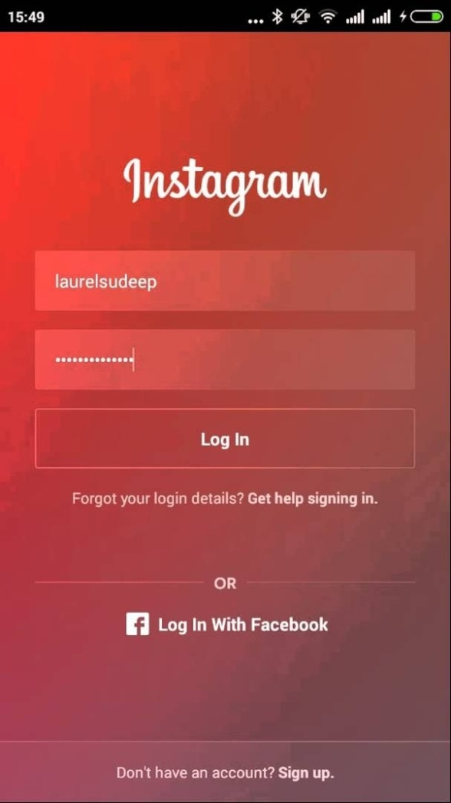

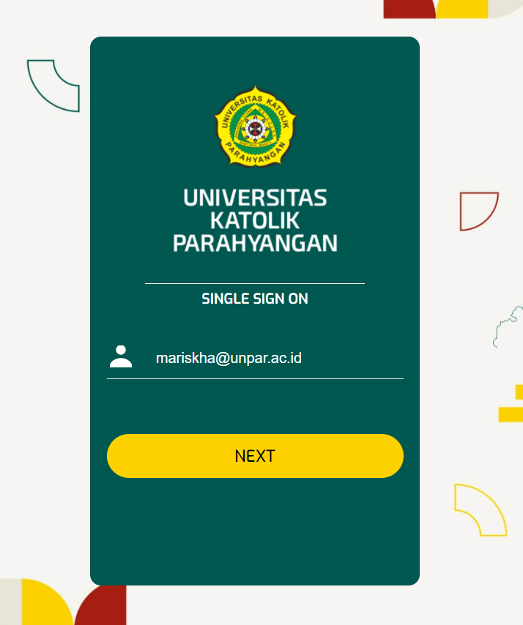
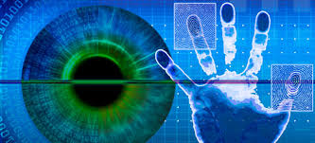
Otentikasi Entitas Contoh

Slide 4
Apa hubungannya?
Check this first:
https://www.nytimes.com/guides/privacy-project/how-to-protect-your-digital-privacy
https://spreadprivacy.com/privacy-resolutions-for-2020/

Slide 5
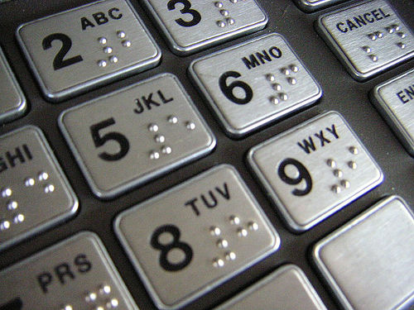
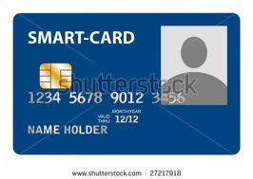
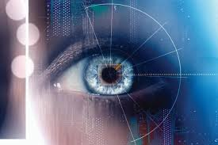
Verification categories
Something possessed
Something inherent
Something known

Slide 6
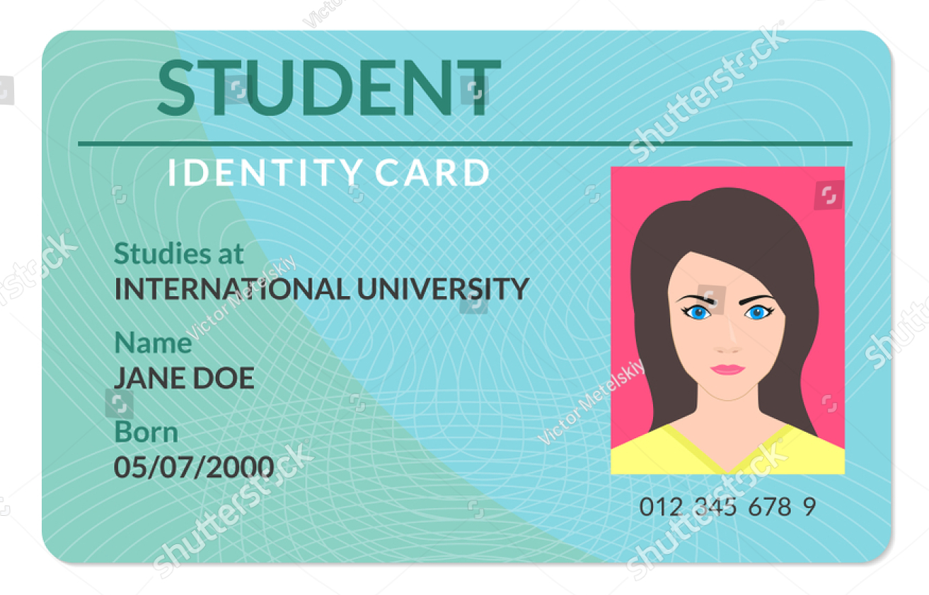
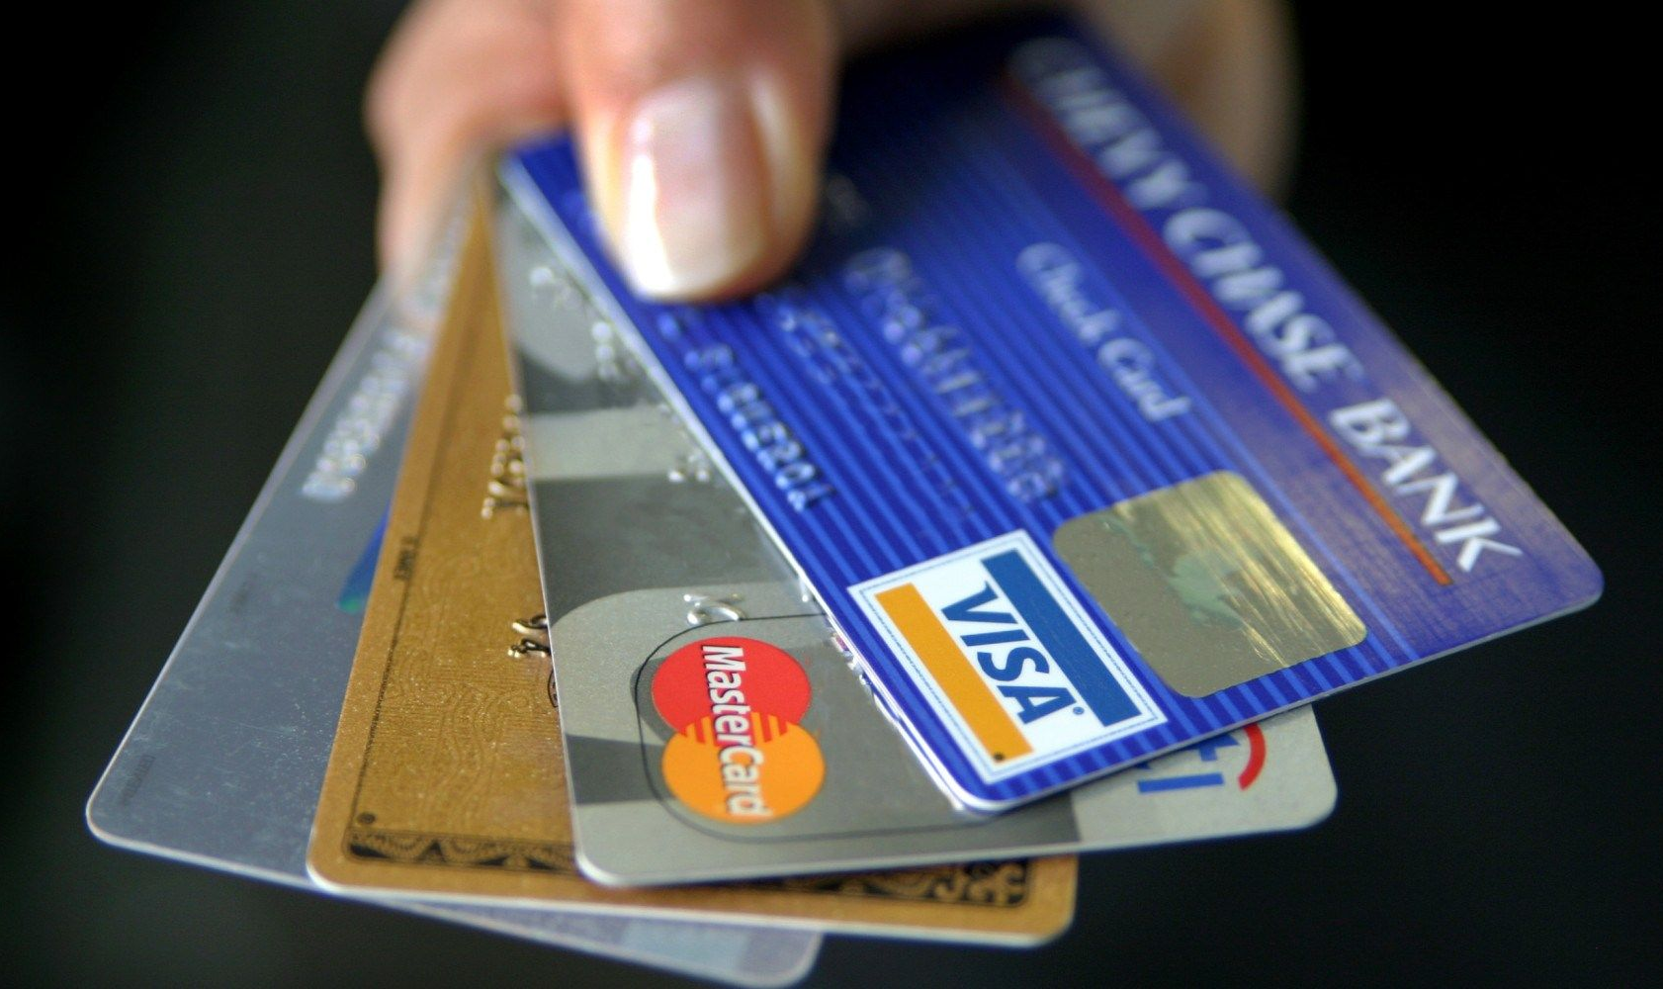
Something possessed

Slide 7
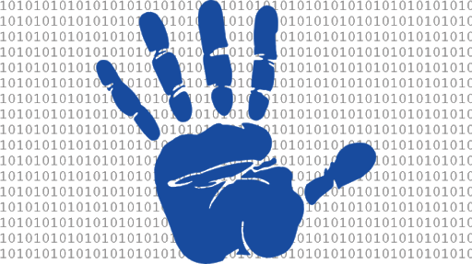
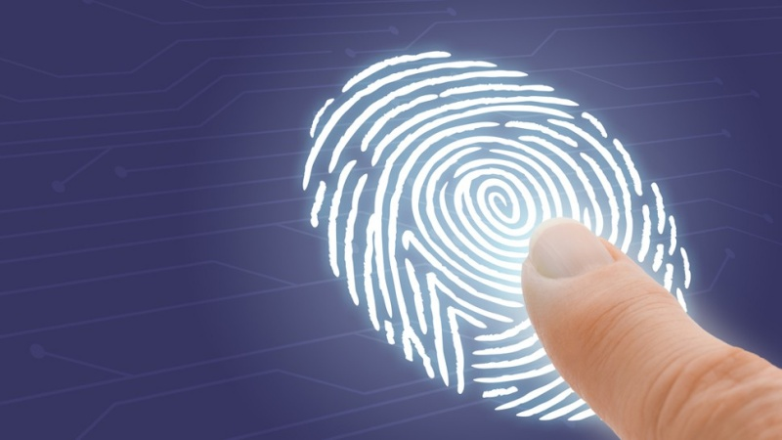
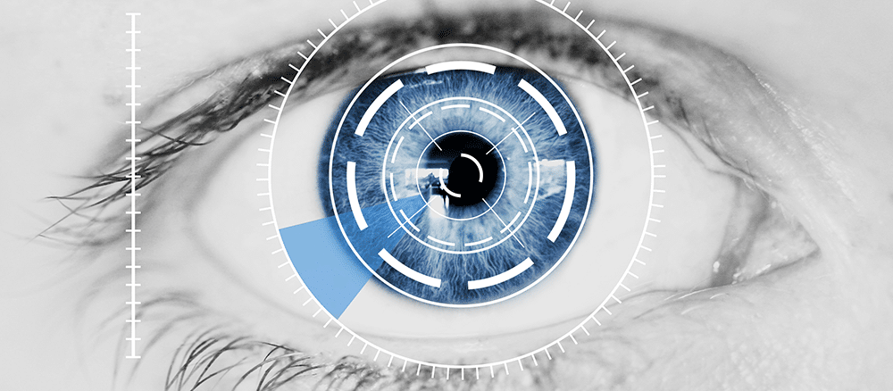
Something inherent - Biometry

Slide 8
Something Known - Passwords
Oldest authentication technique
Two groups:
Fixed passwords
One time passwords

Slide 9
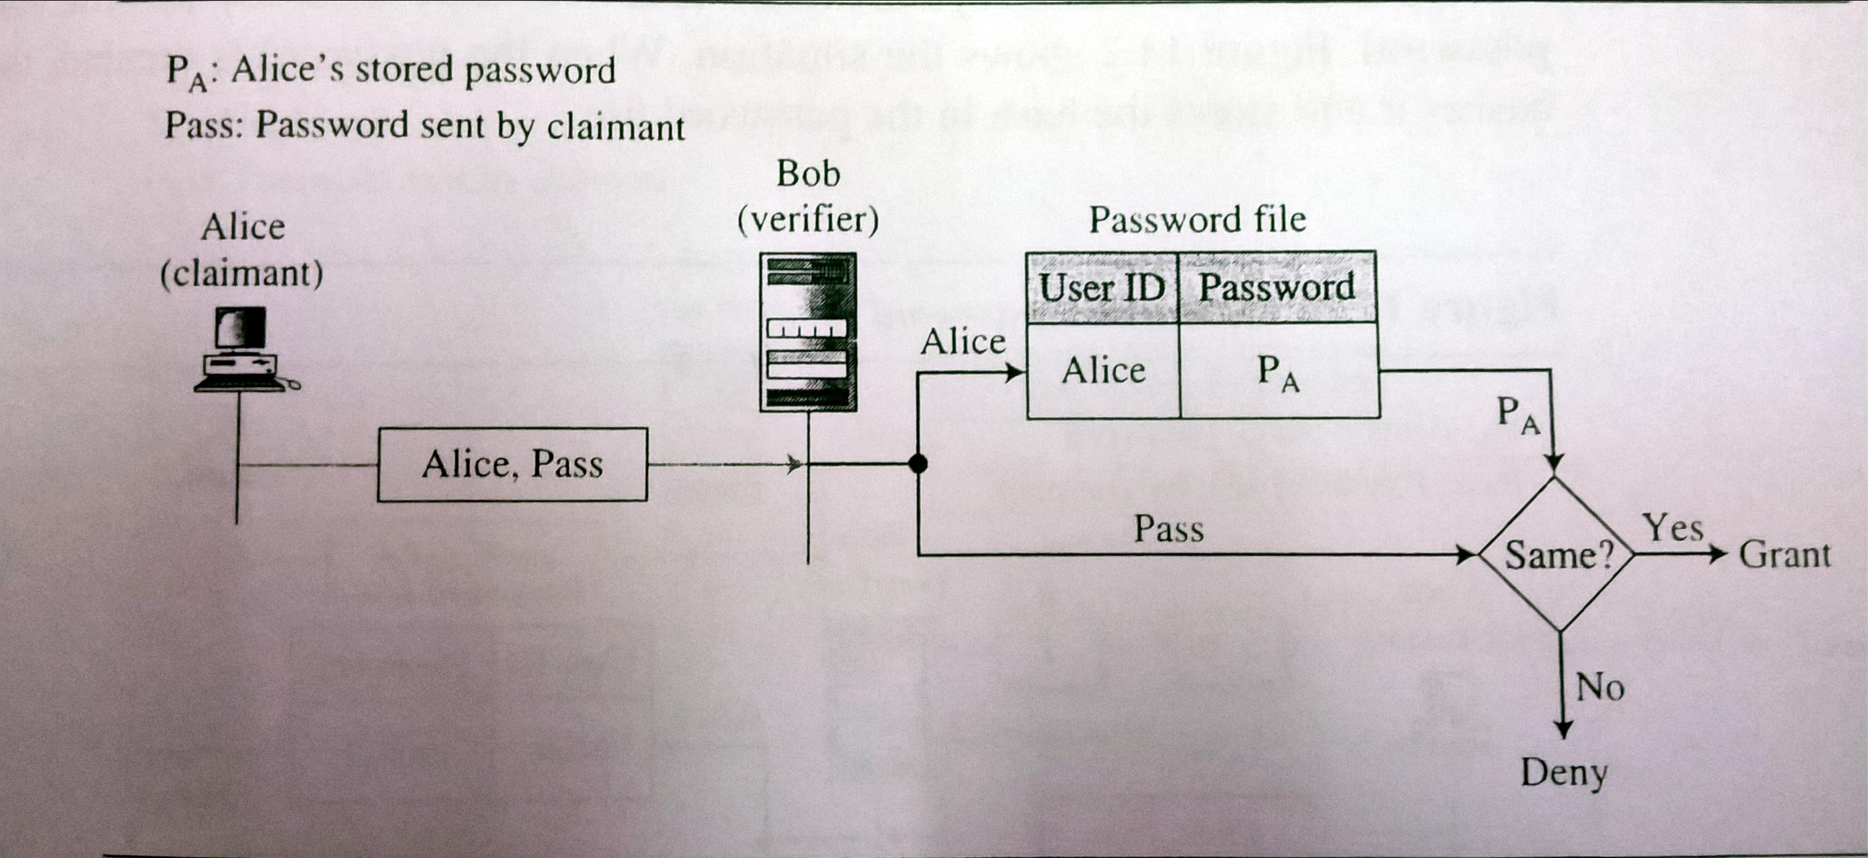
Fixed passwords 1st approach

Slide 10
1st approach - attacks
Eavesdropping
Stealing a password
Accessing password file
Guessing

Slide 11
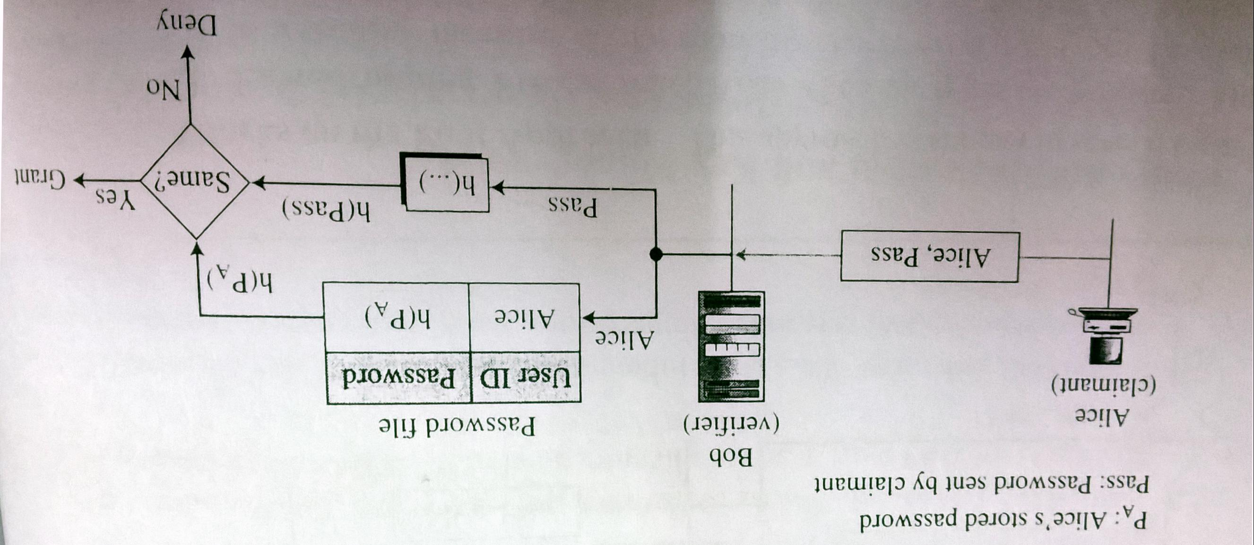
Fixed passwords 2nd approach

Slide 12
2nd approach - attacks
Dictionary attacks
What else?

Slide 13
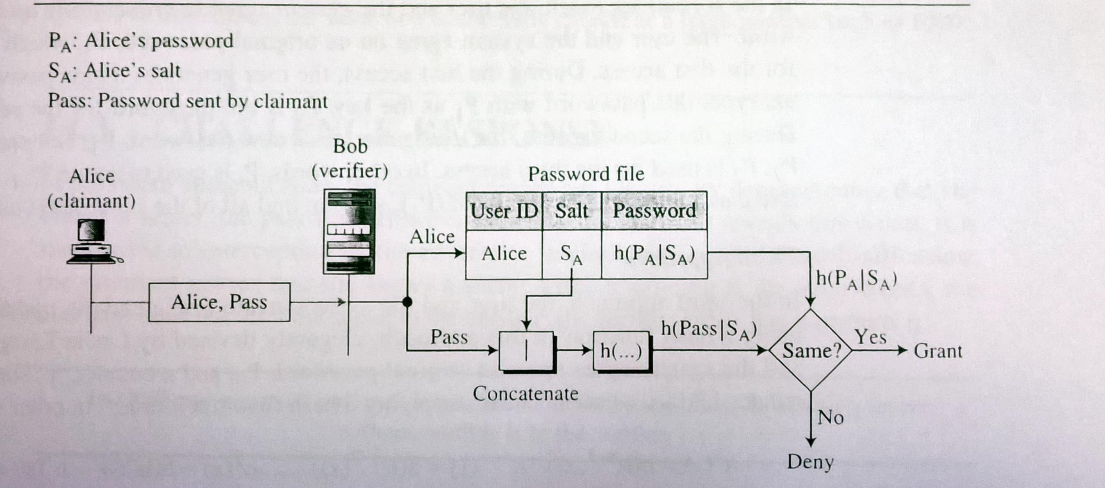
Fixed passwords 3rd approach
Dictionary attack?

Slide 14
Fixed passwords 4th approach
Combination 2 identification technique
Ex. ATM card and PIN

Slide 15
One time password 1st approach
List of passwords
Each only valid once
Drawbacks:
Long list of passwords
If not used in sequence, systems need to perform a long search

Slide 16
One time password 2nd approach
Sequentially update the password
Original password P₁
Generate password P_{i+1} using P_{i}
Drawback?

Slide 17
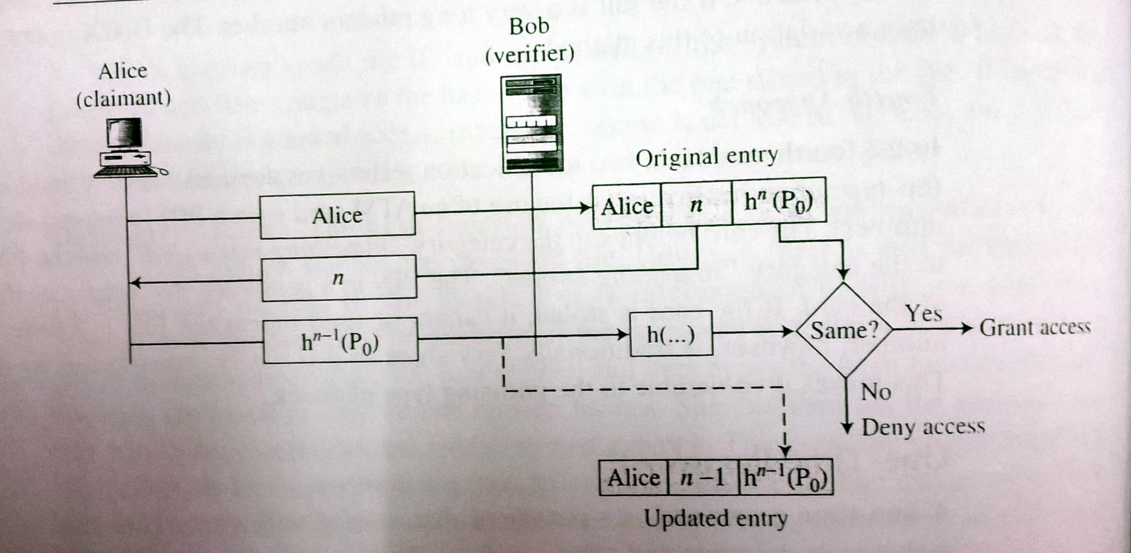
Third approach Lamport one time password

Slide 18
Challenge-Response
The claimant proves that she knows a secret without sending it to the verifier
The challenge is a time-varying value sent by the verifier (nonce)
The response is the result of a function applied on it

Slide 19
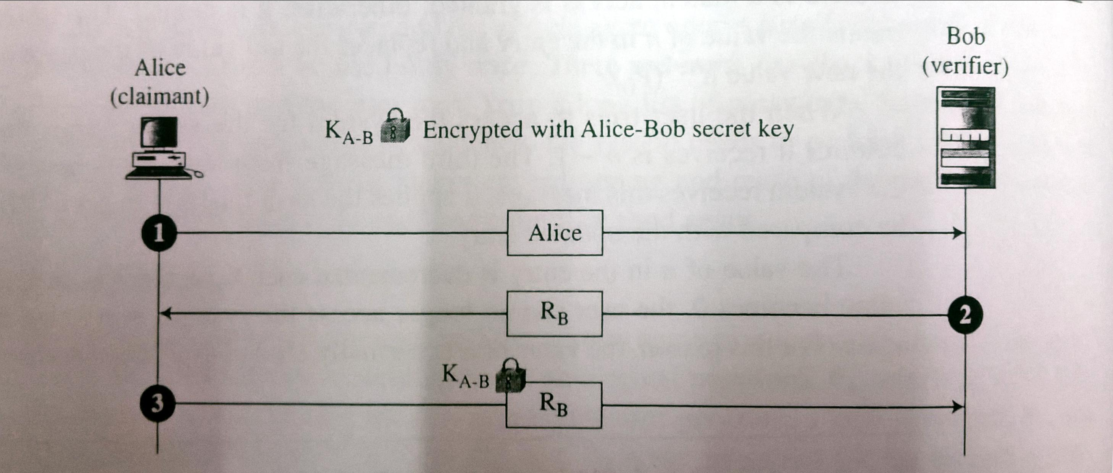
Using symmetric key cipher 1st approach

Slide 20
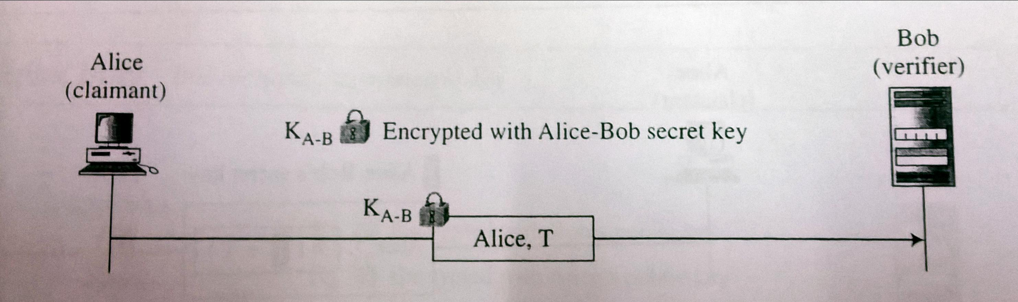
Using symmetric key cipher 2nd approach
The time varying value is a time stamp
The client and server clocks are synchronized

Slide 21
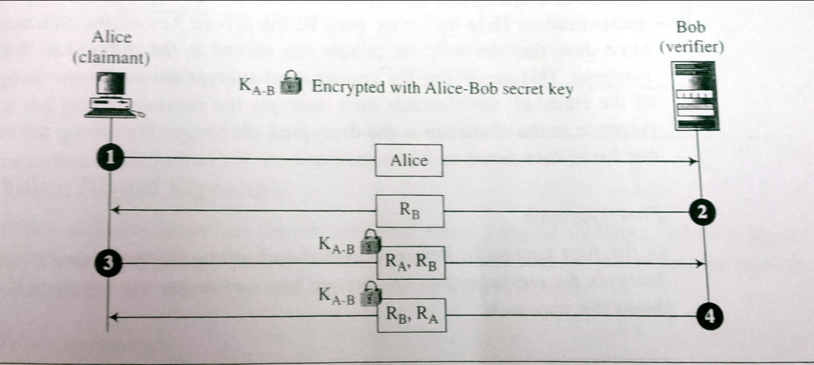
Using symmetric key cipher 3rd approach
Bidirectional authentication
In the 4th message, the order of R_{A} and R_{B} are switched. Why?

Slide 22
Challenge-response in daily life
Google it!

